Slide 1
12 Principles of design
ietf.org

Slide 2
1- Visibility
Some of the available functions of the website could be seen clearly. However, some features are a bit hidden.
Positive points:
Some arrows are added next to the available lists in the nav bar
Donate Button is clearly inserted at the top of the page
Negative points:
The search option is included to the other options, so it became not clear enough
Some buttons are not seen such as “More information” or too small “All topics” button
Contact IETF developers teem is not located among the “contact” section but among “support us” instead.
Rating: (2.5/5)

Slide 3
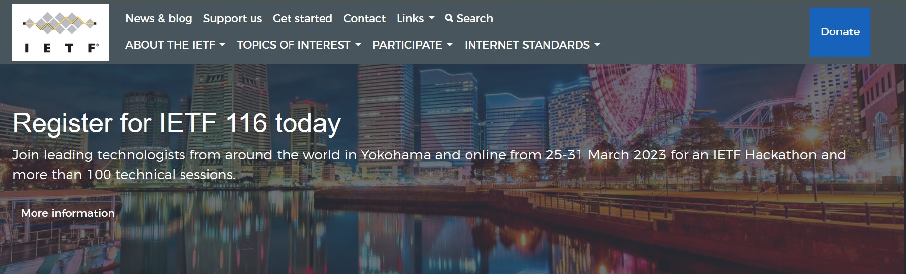
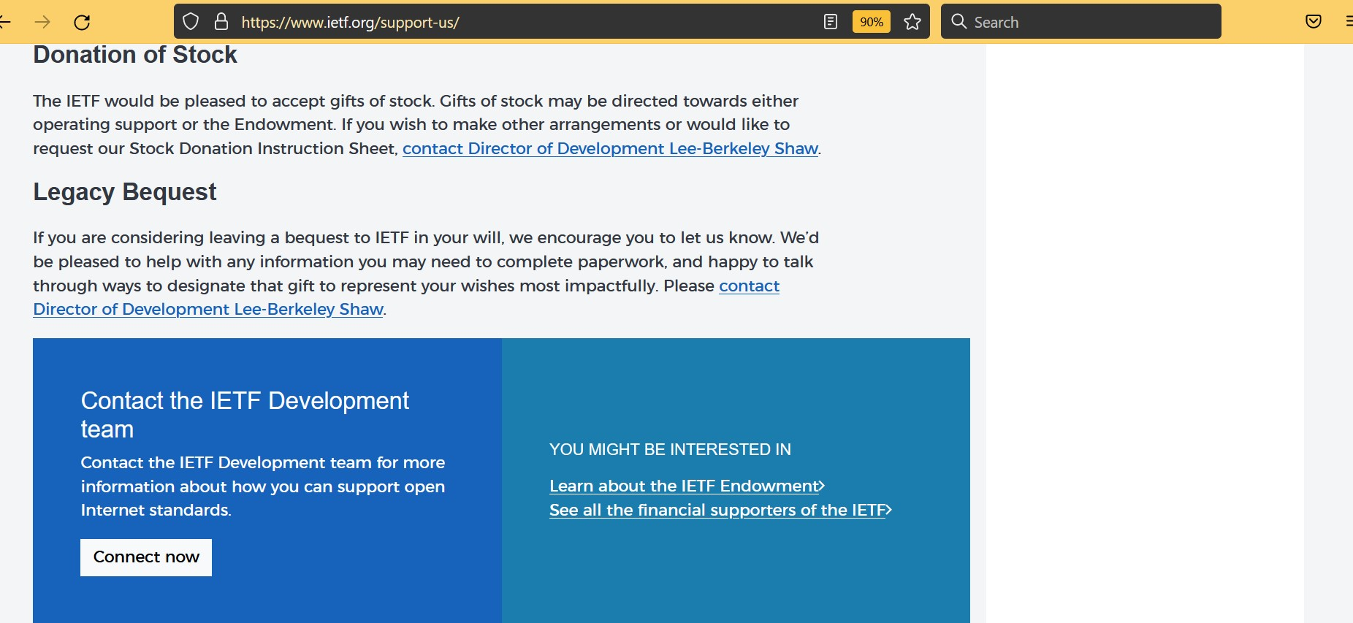
1
2
1
2
3

Slide 4
2- Consistency
Most of the website layout is consistent its view and navigation methods. However some pages have menus that is not existed in other pages. Plus, The navigation bar is different in some domains.
Positive points:
The navigation bar is similar at the all pages that are mentioned in it (News & blogs, Support us, Contact, ….)
Similar footer in the pages of the same domain (ietf.org/&&&&)
Similar layout for different section
Negative points:
Different navigation bars in different domains
The navigation menu is not existed in all pages
Rating: (3.5/5)

Slide 5
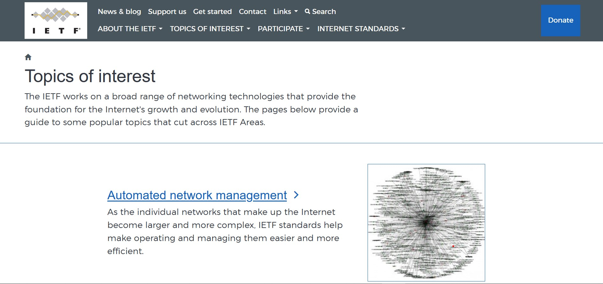
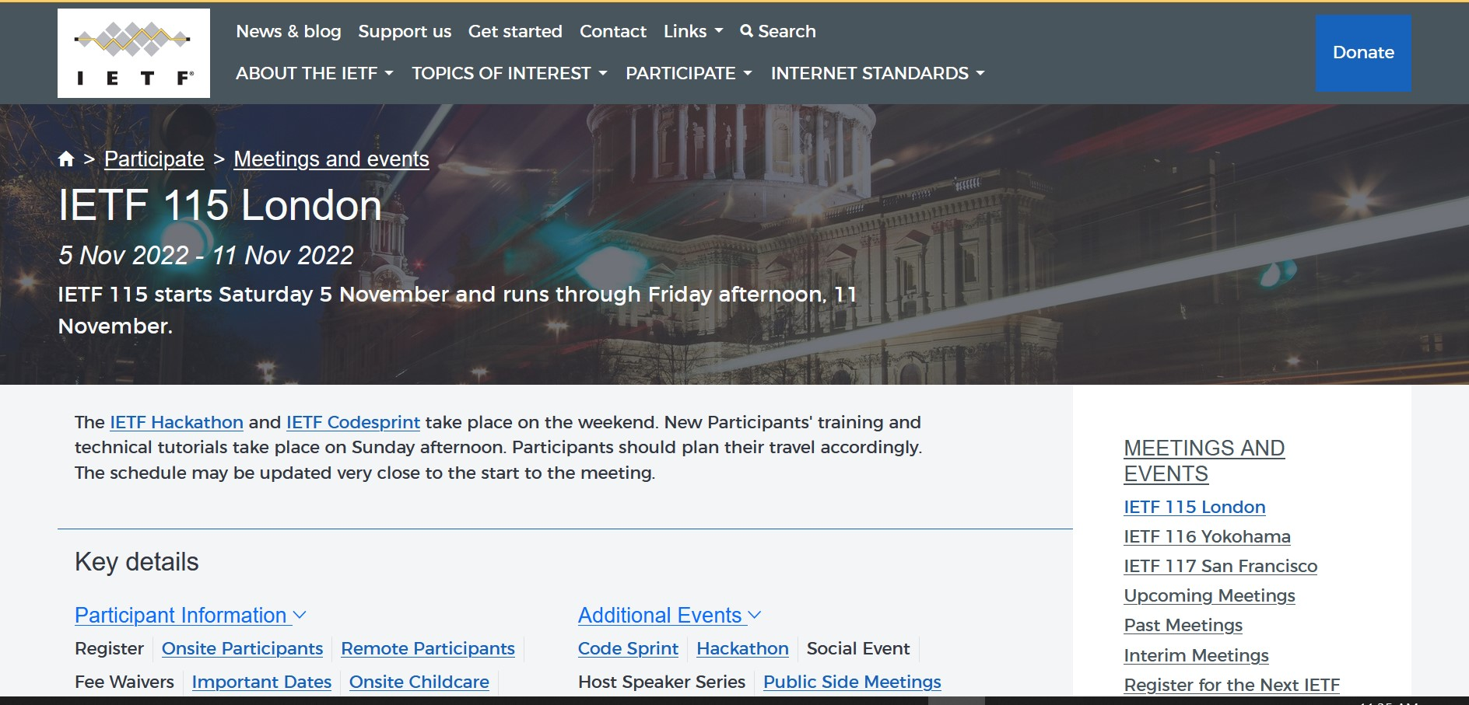
1

Slide 6
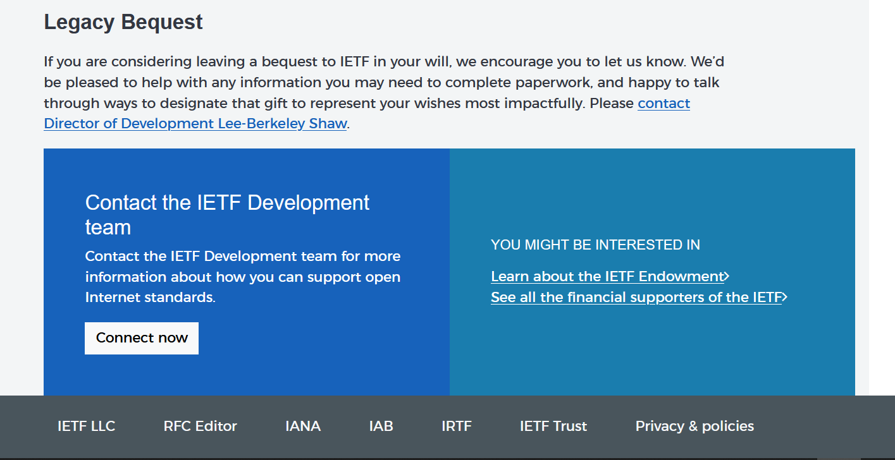
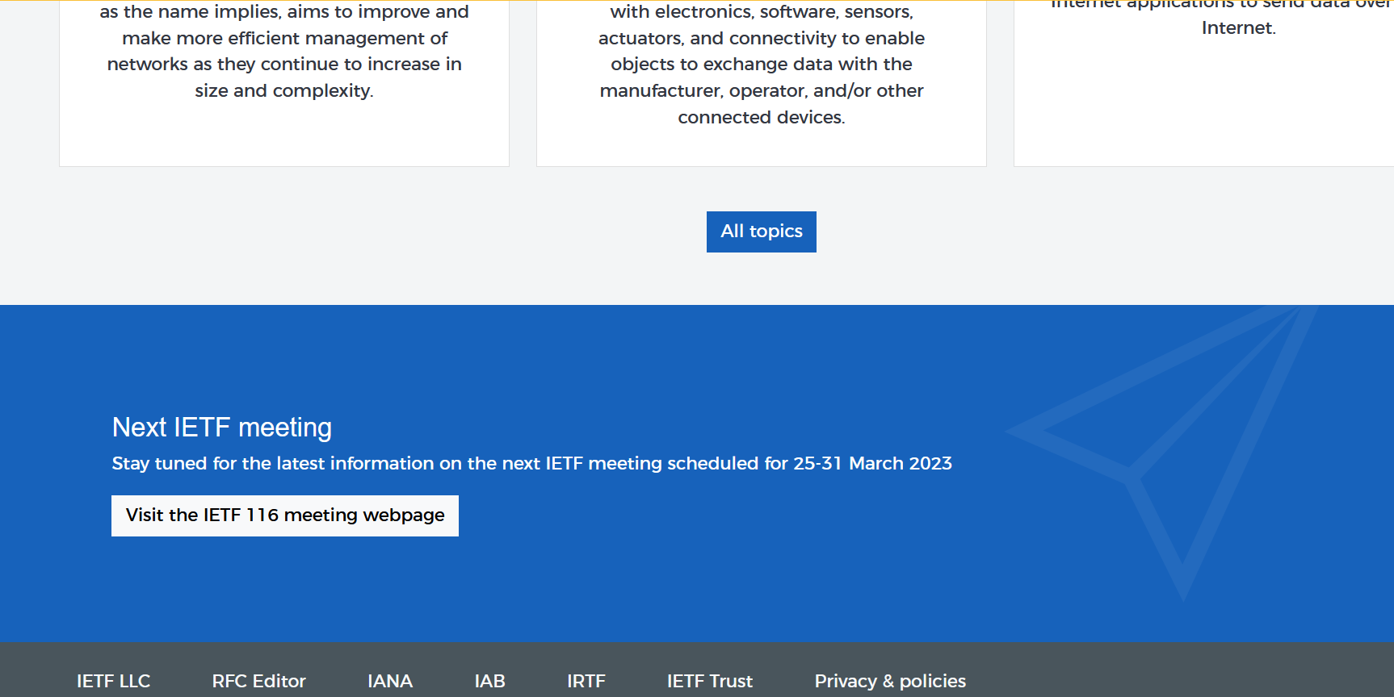
2

Slide 7
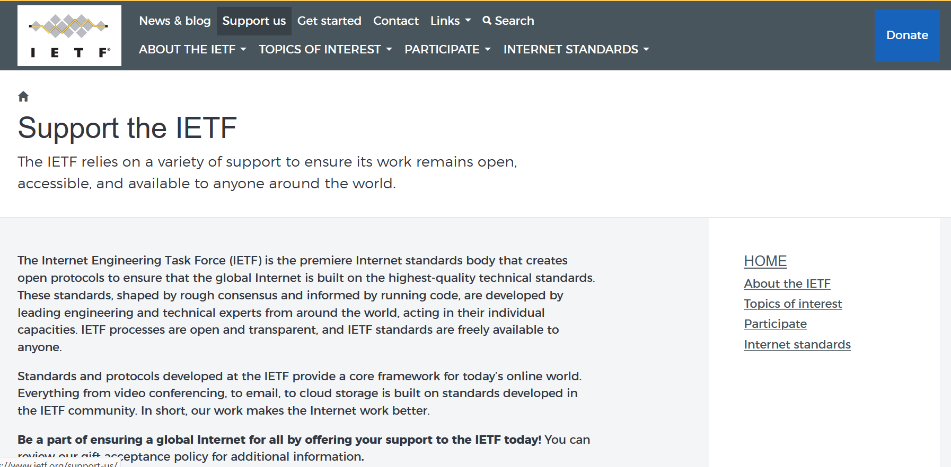
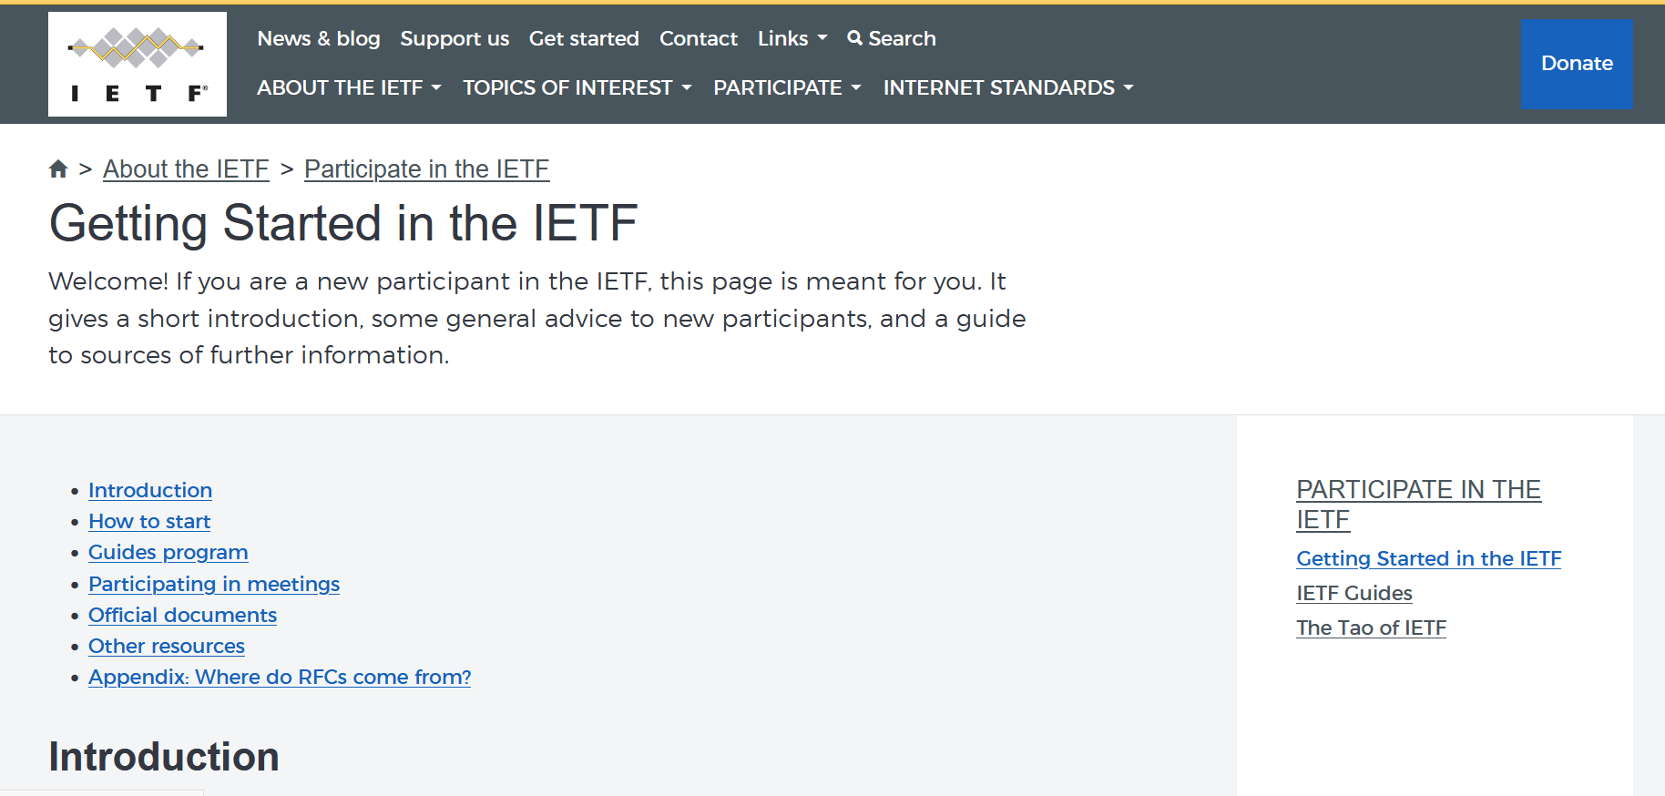
3

Slide 8
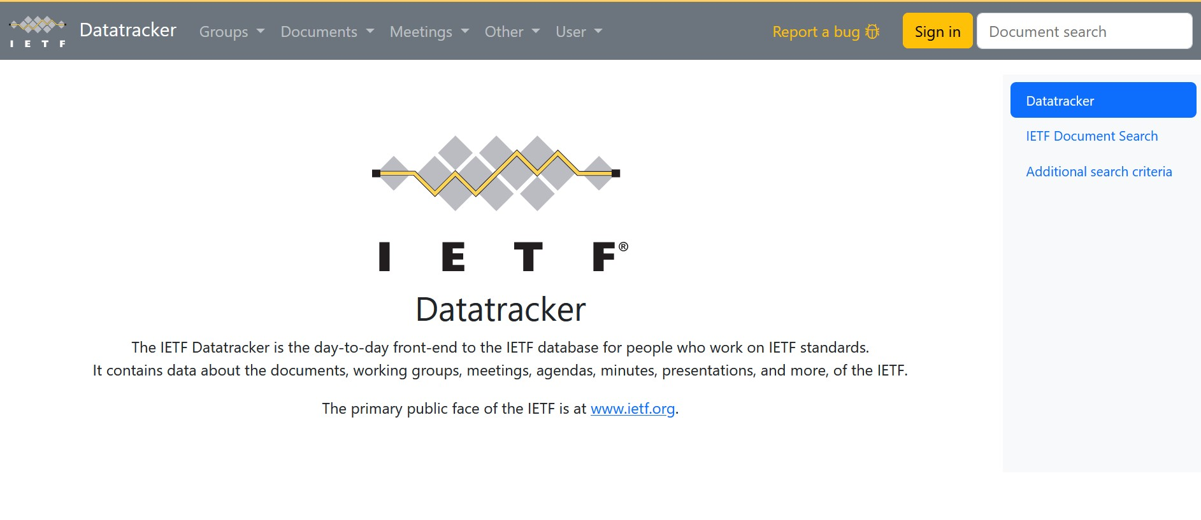
1

Slide 9
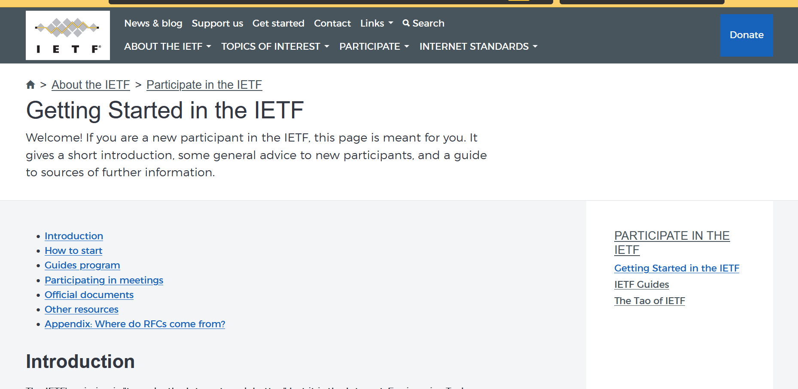
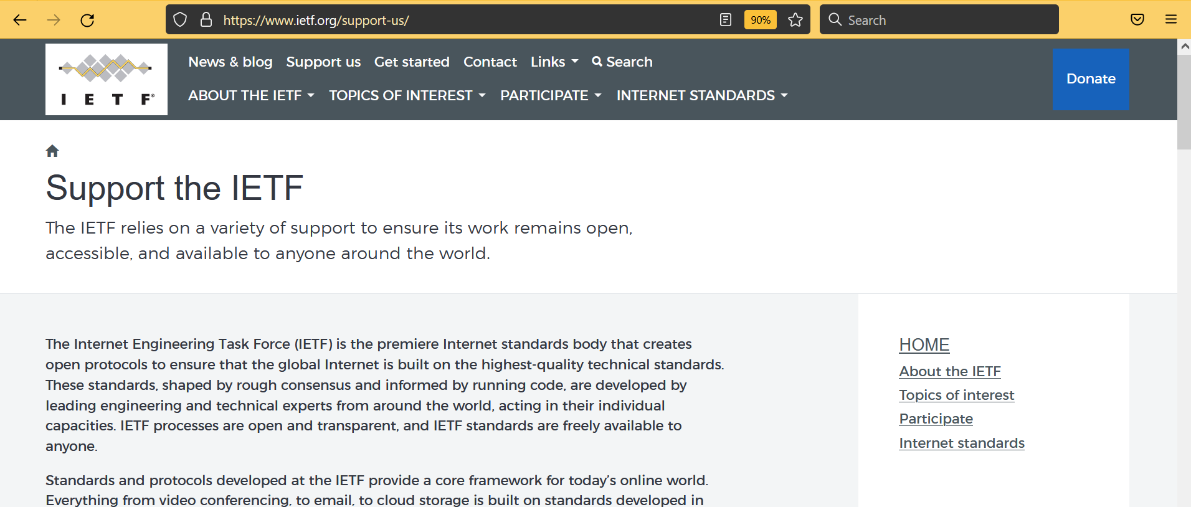
2

Slide 10
3- Familiarity
According to the web activities and the target audience, the web site is mostly familiar to its users.
Positive points:
The web language is only in English which is good enough for its users, since the organization service is only preformed in USA
The use symbols are pretty familiar such as that is next to the search option
The search bars are created to be familiar, easy to use and attached with a specific description to what it searches for
Each payment method has a button that points to it clearly in a very familiar way.
Negative points:
The error message that comes while donating is not readable by normal people.
Some options in the footer are not understandable like “IAB”, “IANA” and open other unexpected pages (other sites).
Rating: (3/5)

Slide 11
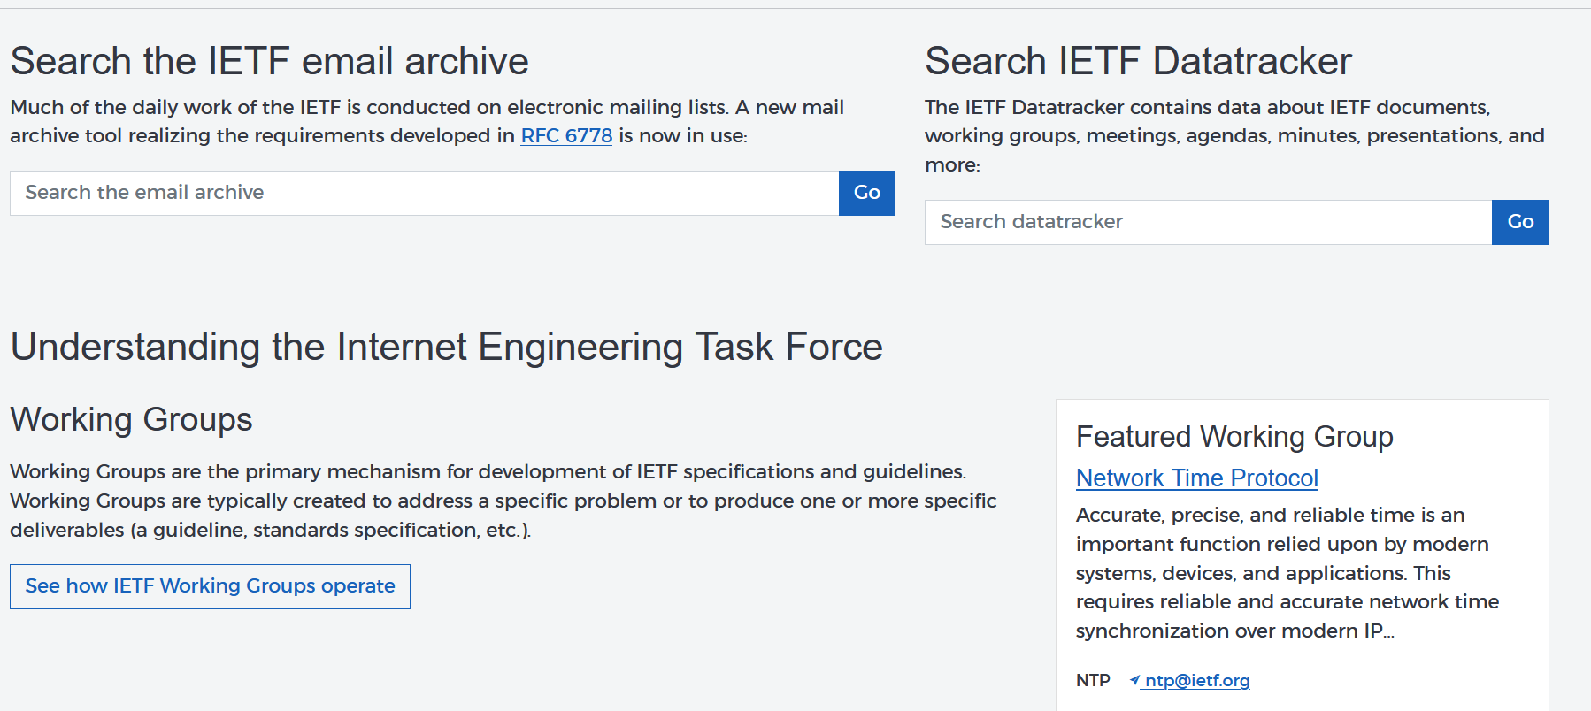
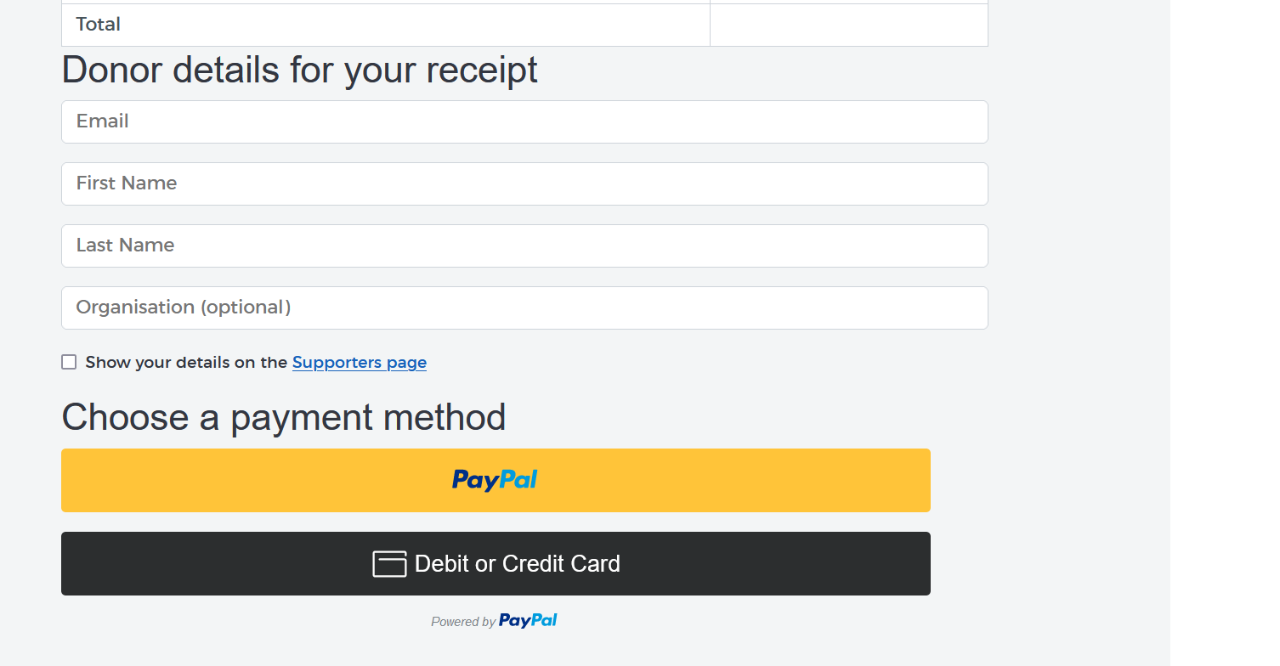
1
2
3

Slide 12
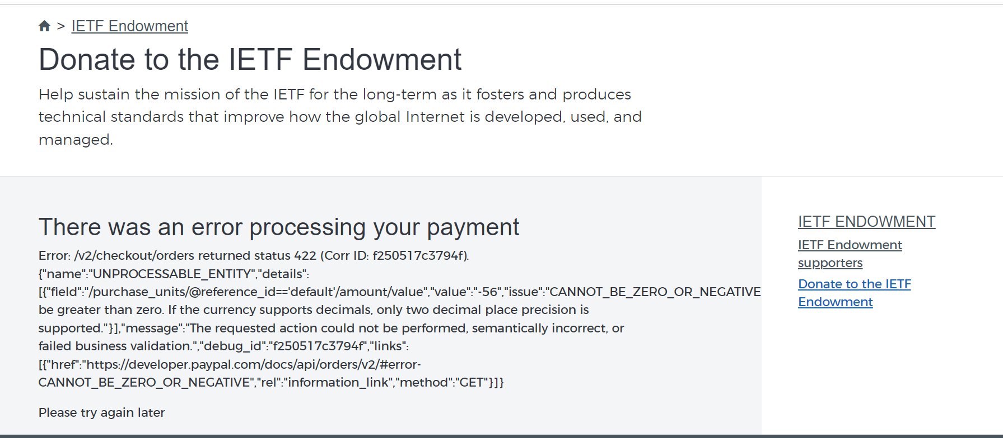
1

Slide 13
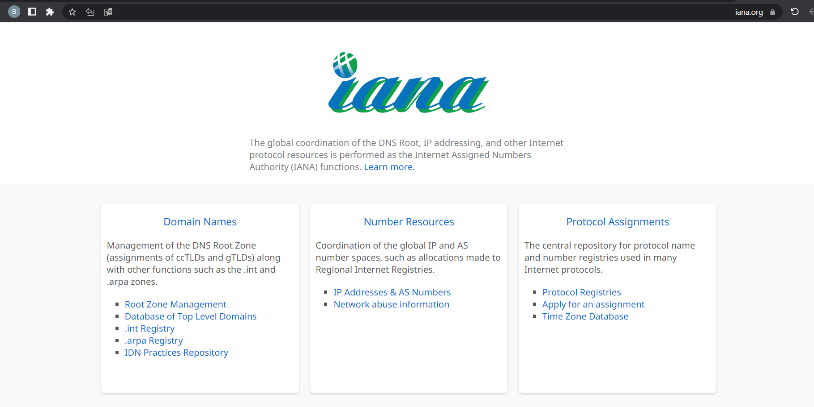
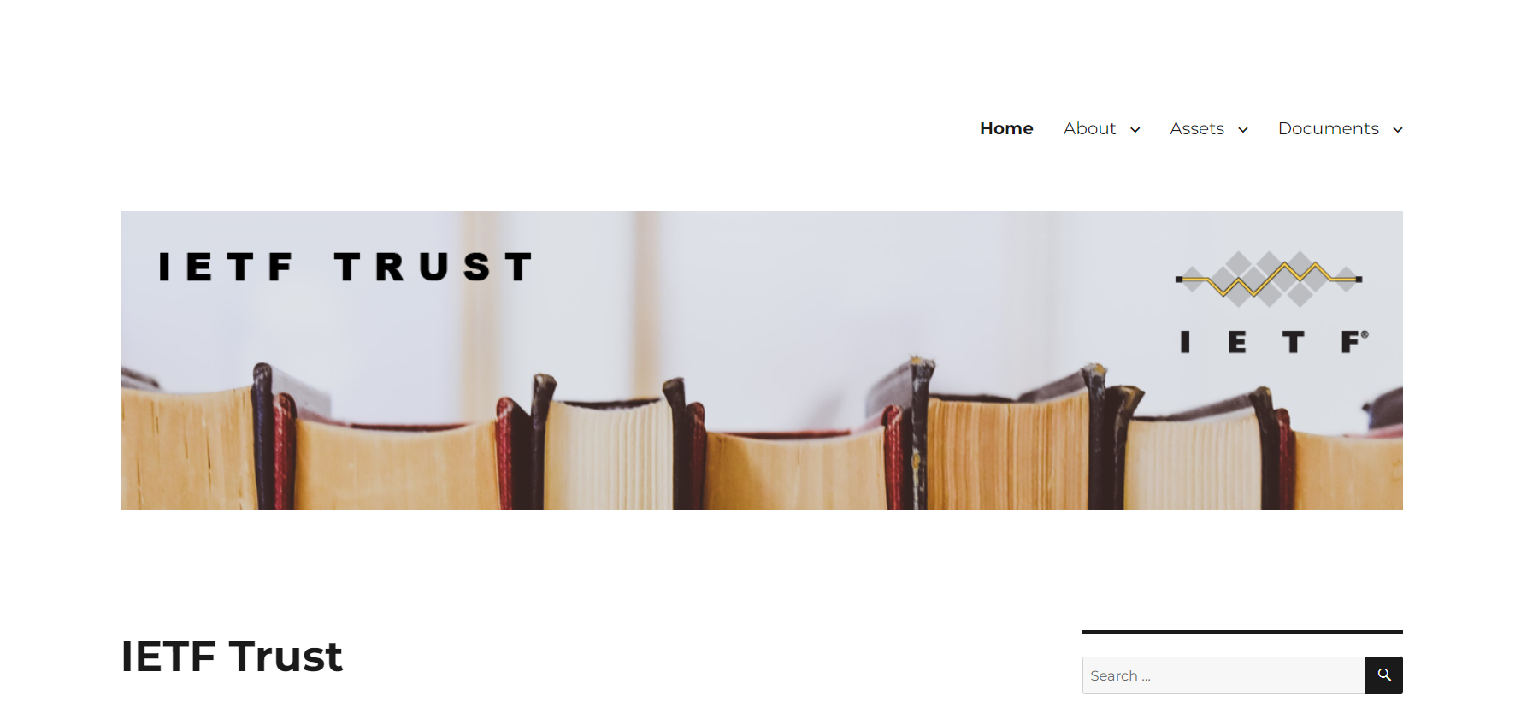
2

Slide 14
4- Affordance
Most of the web UI is clearly usable and suitable to its target audience, However some components are not clearly present their functionality.
Positive points:
Since the website targets many experts and specialists of technology, the used pictures are good enough to understand the section title.
The filtering method is typical to other web applications.
Negative points:
Some pictures are anonymous and do not present its topic enough.
The navigation buttons at the bottom of the “News and blogs” page are different than other normal web applications.
Rating: (2.5/5)

Slide 15
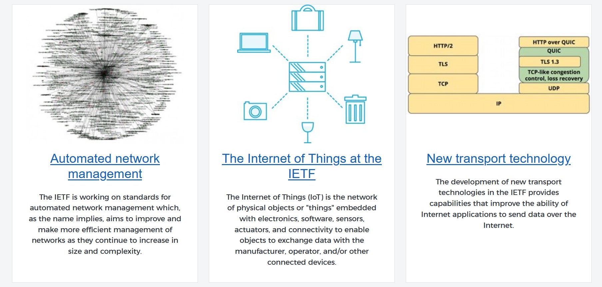
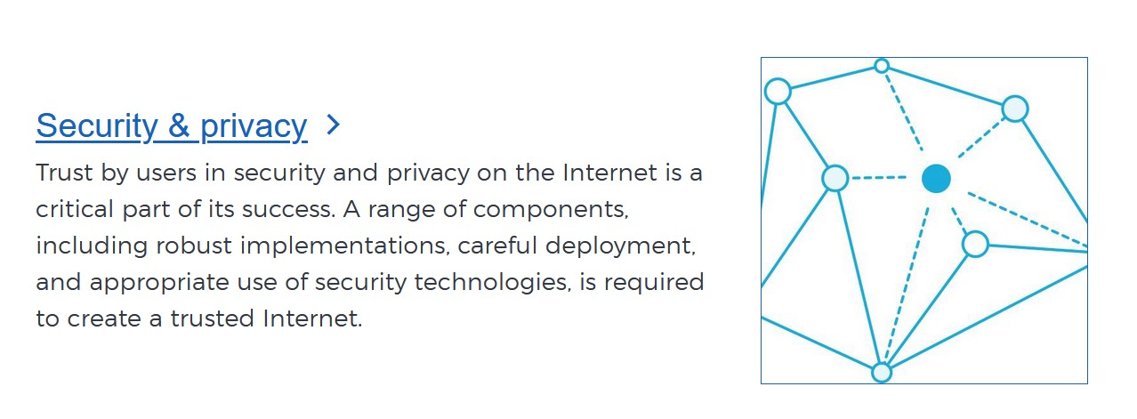
1
1

Slide 16
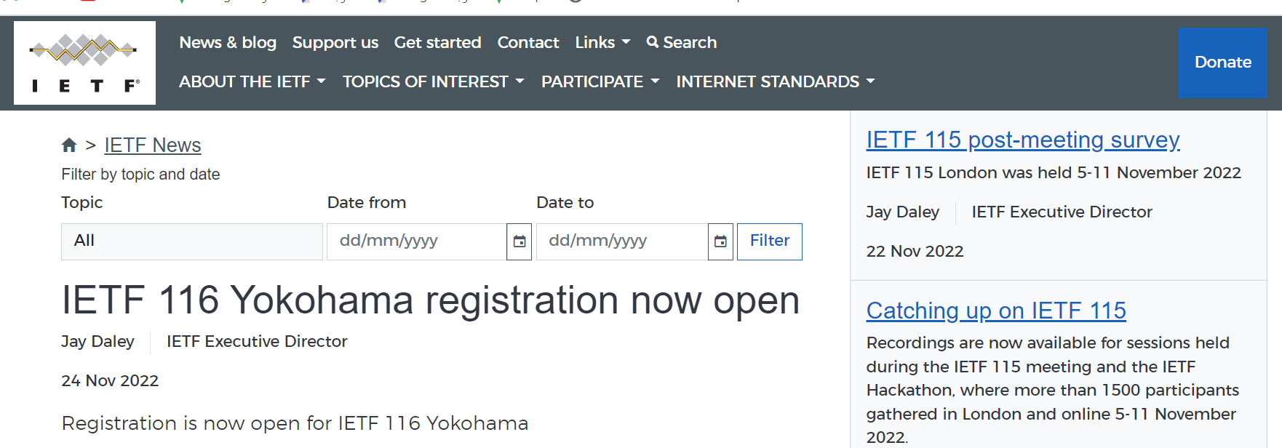
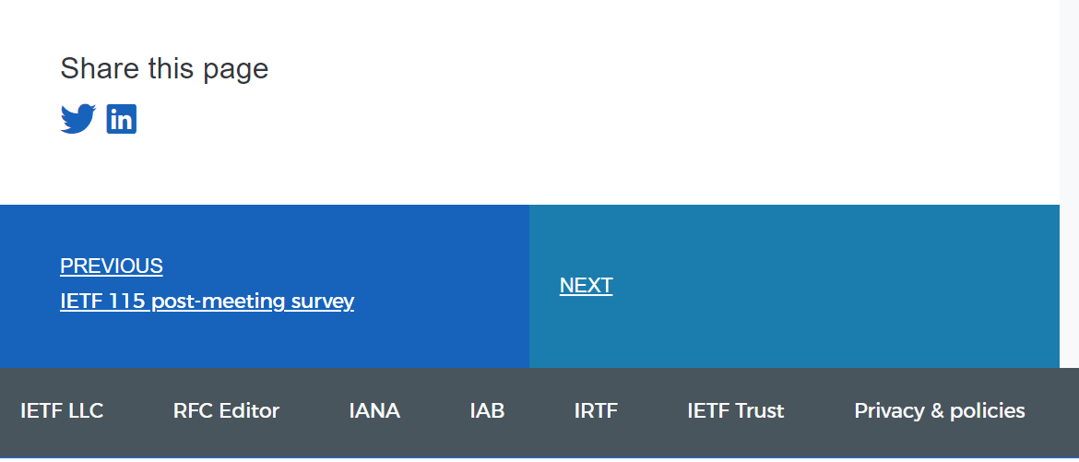
2
2

Slide 17
5- Navigation
The website provides a top navigation bar to enable people to move around the different parts of the system. Plus, it provides some additional menus to support easy navigation.
Positive points:
Navigation bar that contains the main sections of the website.
Additional menus that supports navigation through each section.
Inner link to helps users know where they are from the home page and navigate accordingly.
Negative points:
The navigation bar is not fixed
The footer has nothing to do with the navigation bar and leads to other websites.
Rating: (4/5)

Slide 18
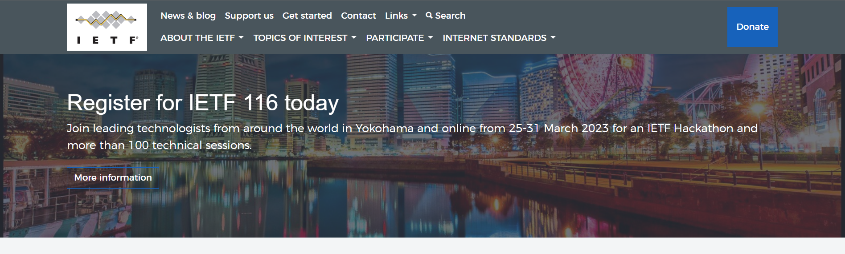
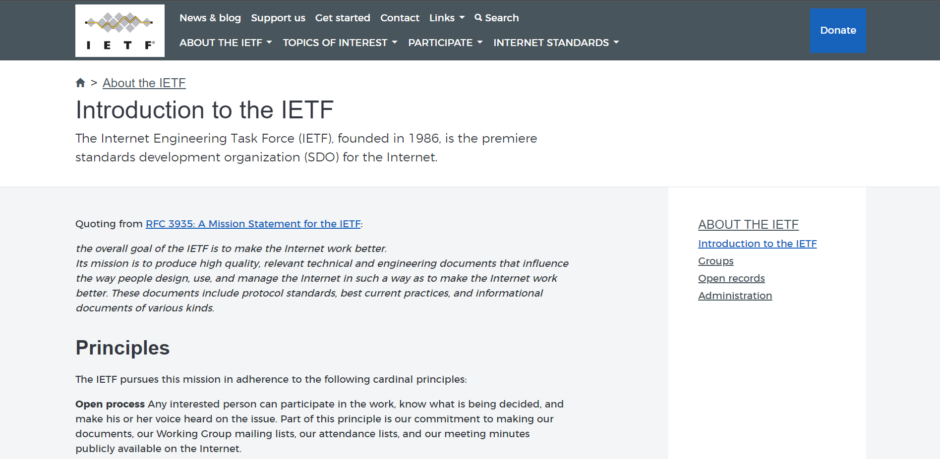
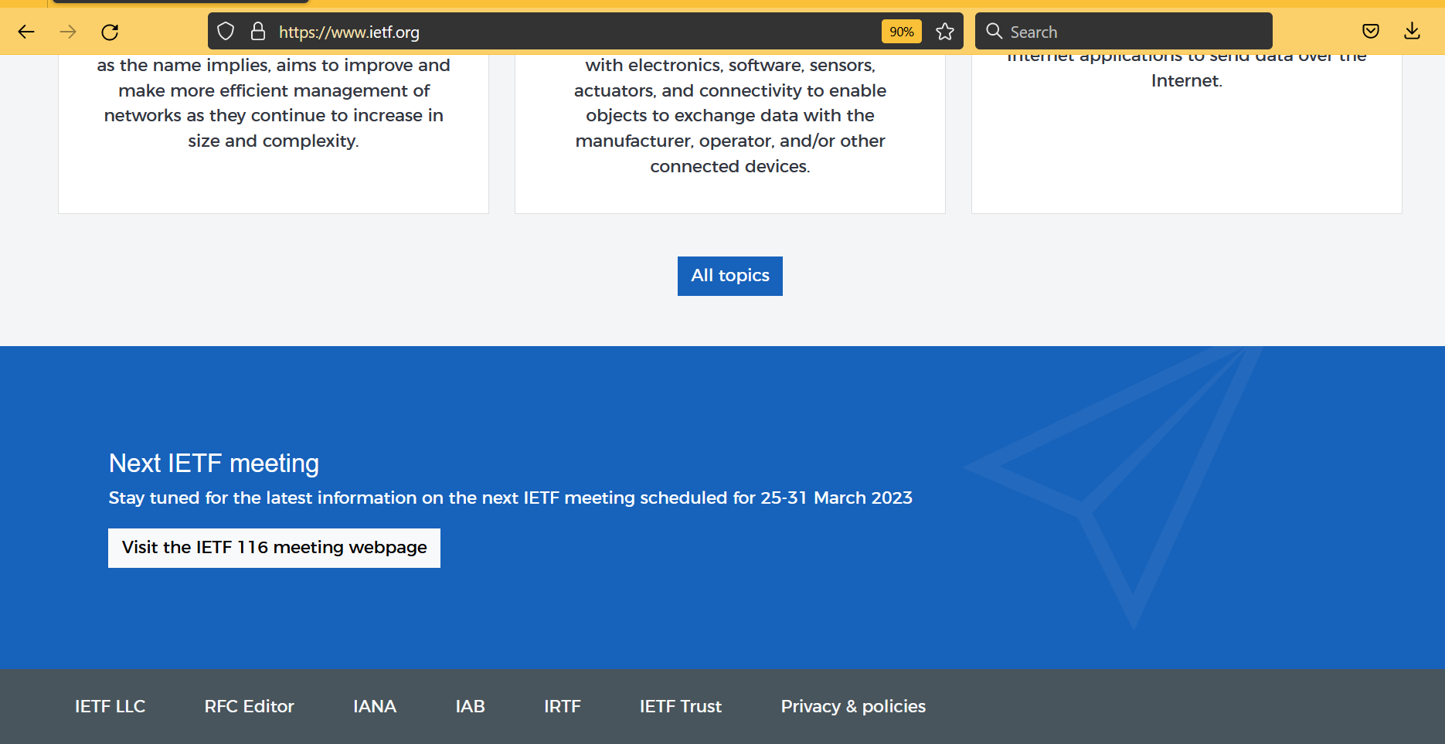
3
2
1
1
2

Slide 19
6- Control
The website enables users to control some views and functions, and it’s clear what can be controlled by users.
Positive points:
These Search Engines enable the users to control the appearance of the page they want.
Filter button makes the user able to know the news of the site in the time period that he wants.
Negative points:
The website doesn’t provide a view control, but it’s still acceptable for that kind of business.
Rating: (4.5/5)

Slide 20
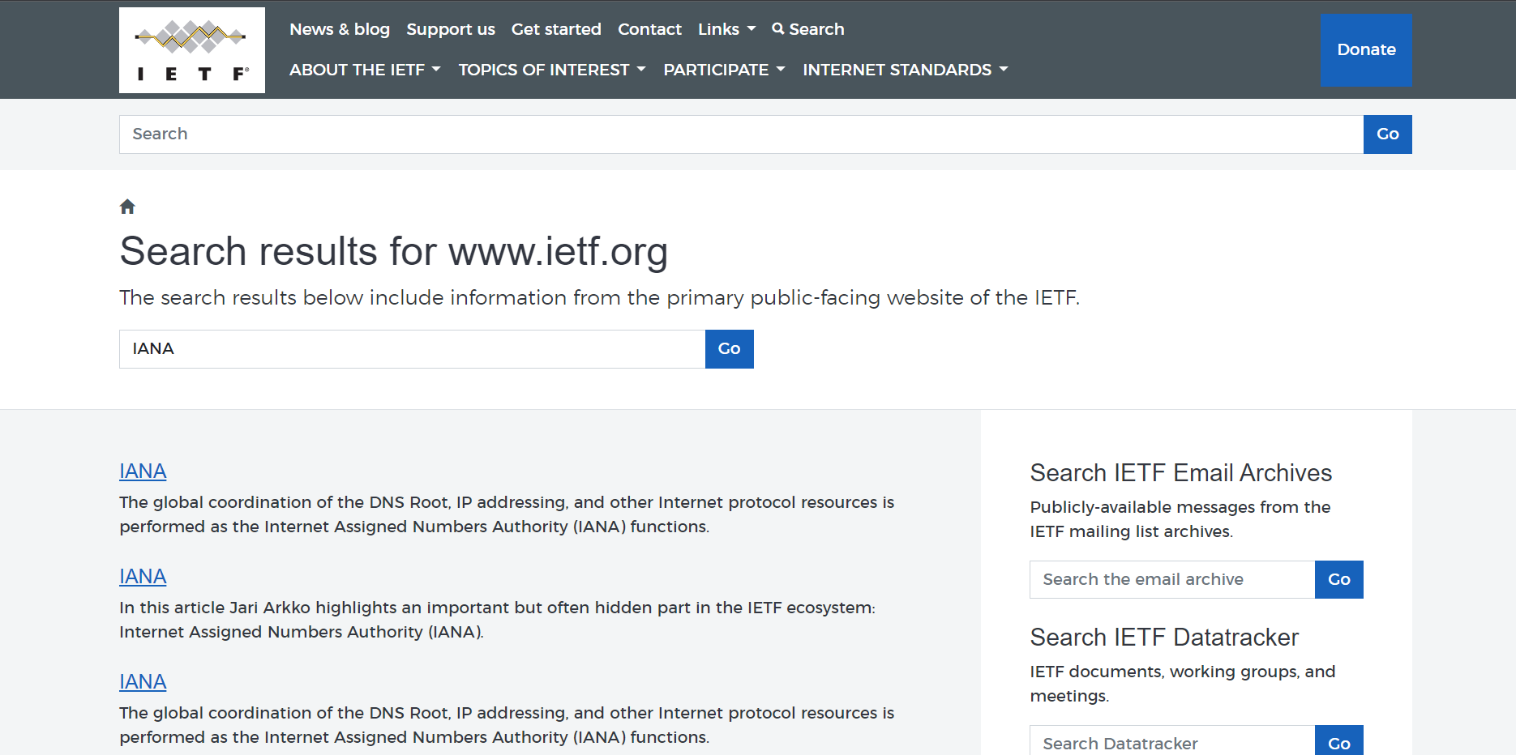
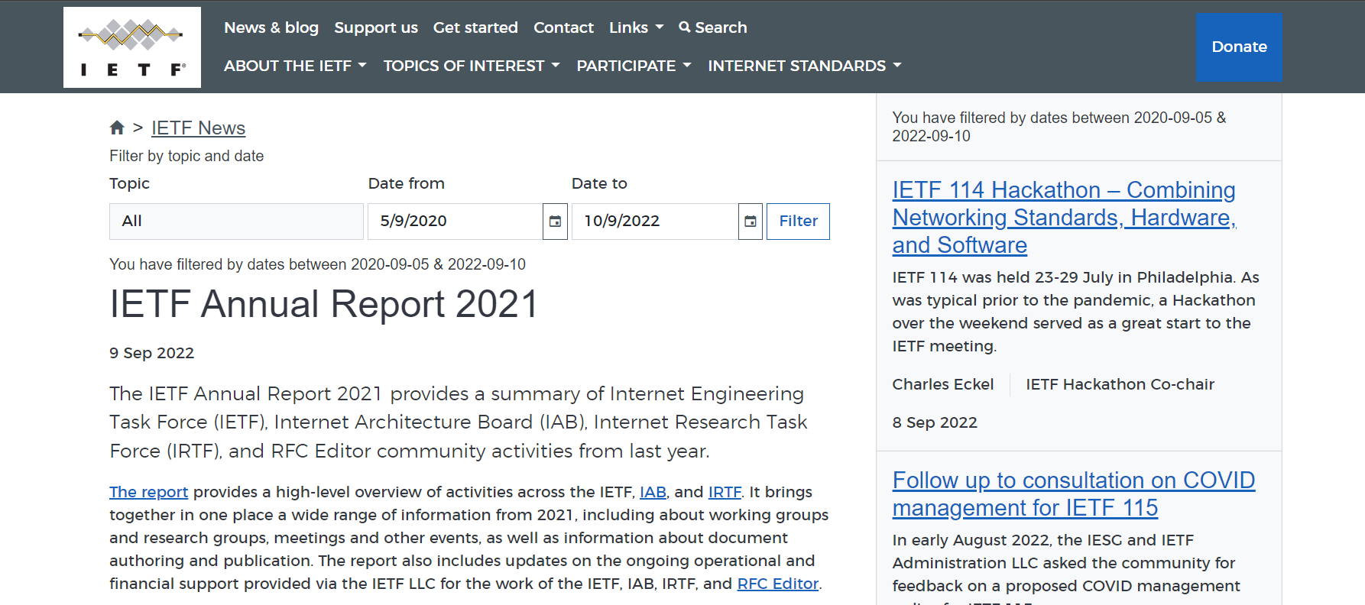
1
2

Slide 21
7- Feedback
Most methods give people faster feedback information, that helps them to know what effect their actions have had.
Positive points:
Loading feedback gives users the effect that their action had.
Message feedback told the users if their submission did well or not.
Negative points:
some pages have no feedback when it’s loading.
There is no feedback showing the reason of the error.
Rating: (3/5)

Slide 22
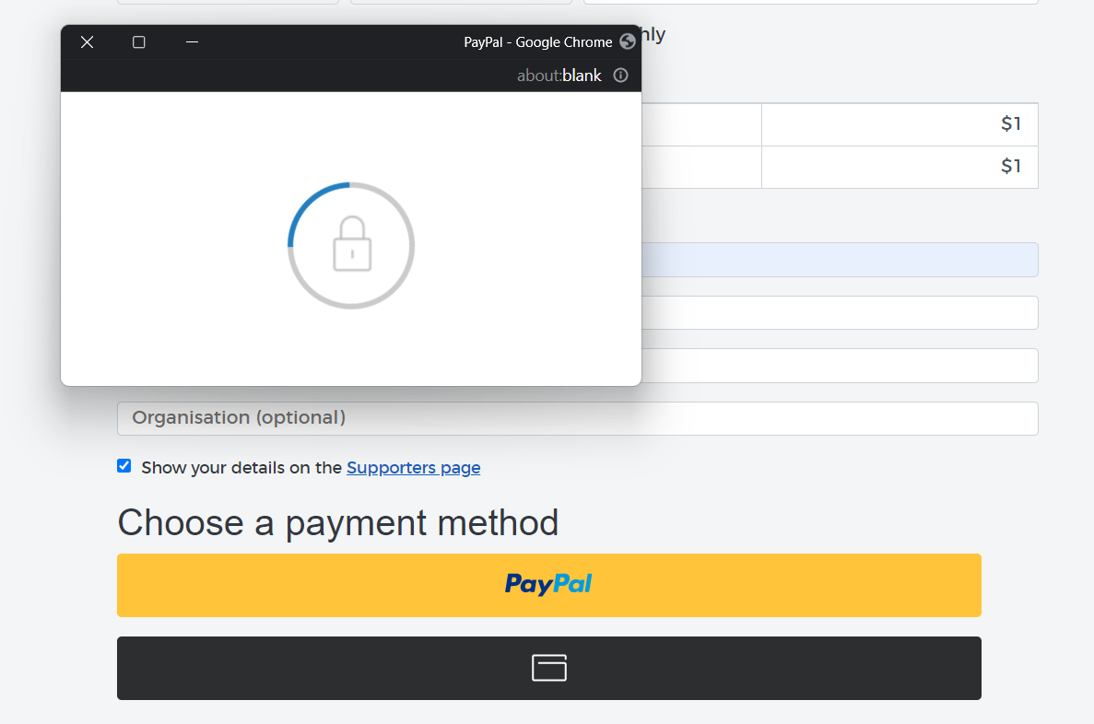
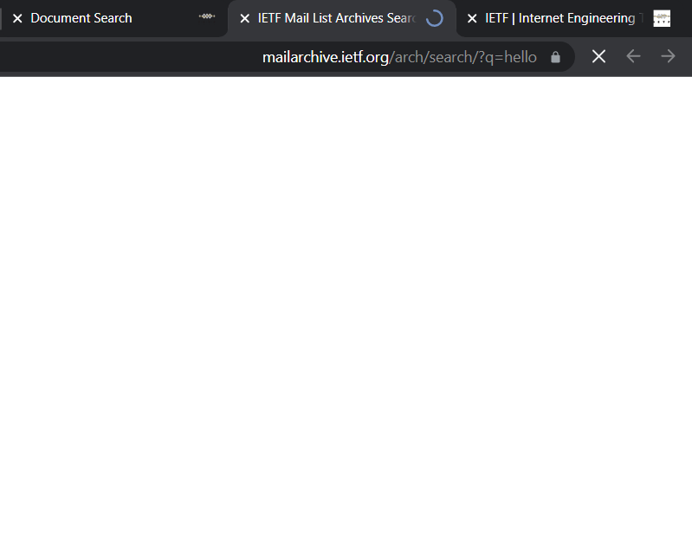
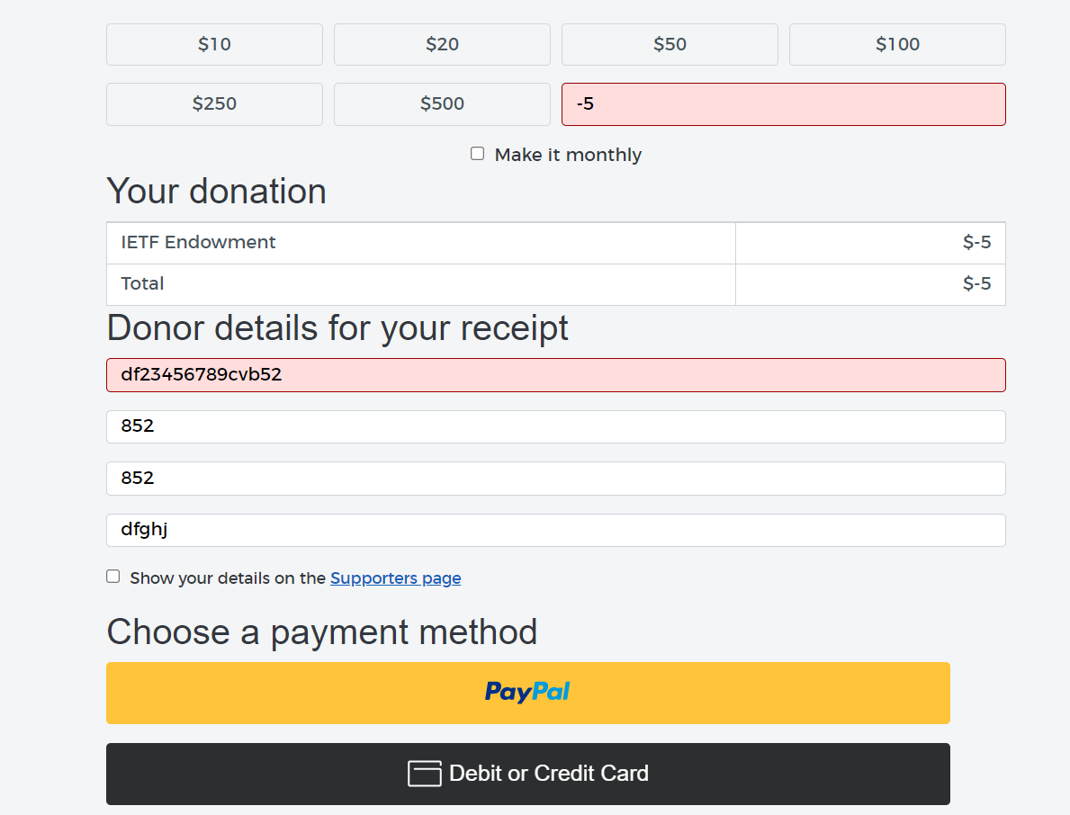
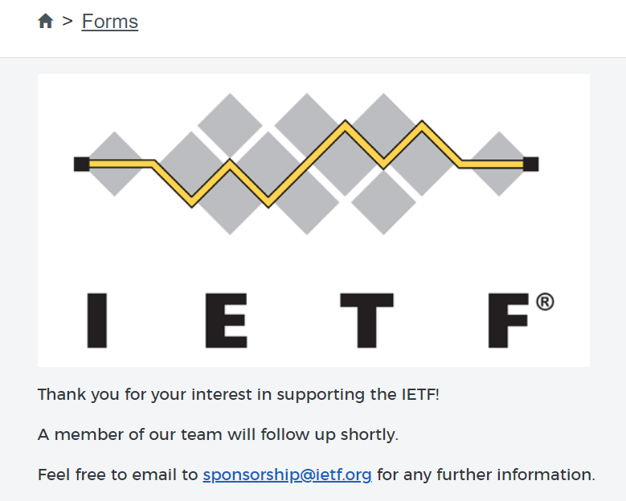
1
1
2
2

Slide 23
8- Recovery
The site has some methods that enable users to recover from their actions, errors, and mistakes quickly and effectively.
Positive points:
In case of entering a page of the search results by mistake and got back to the previous page (the result page), the search text and results remain the same.
In case of the email is not correct or empty, once the credit card button is clicked, The field turns to red and allow user to re-edit or enter the data without deleting the other entered date.
Negative points:
When a faulty data is entered to the amount field, the whole page get crashed without any way re-edit it.
When the user leaves the page without completely donating, there is no alert message to notify him that the transaction is not completed.
Rating: (3/5)

Slide 24
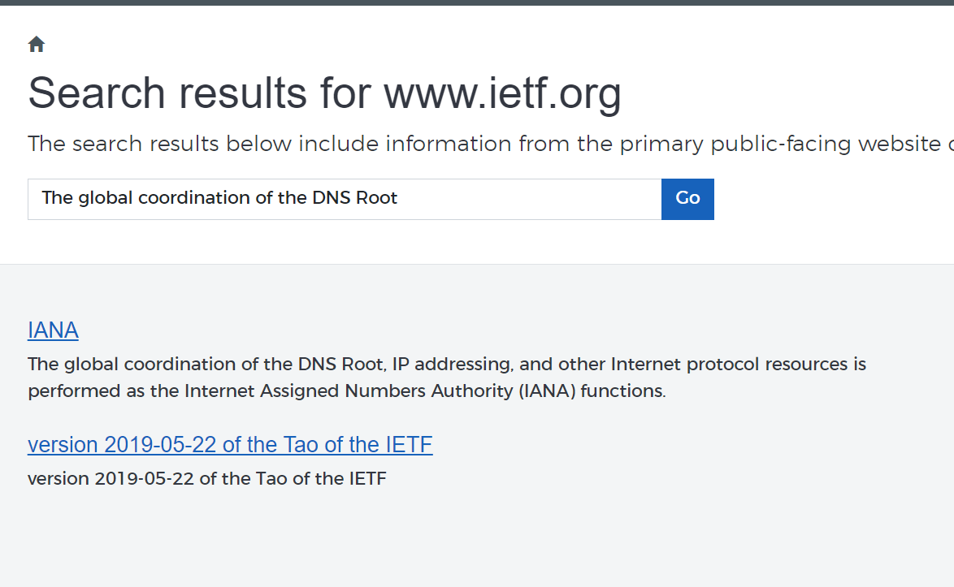
1

Slide 25
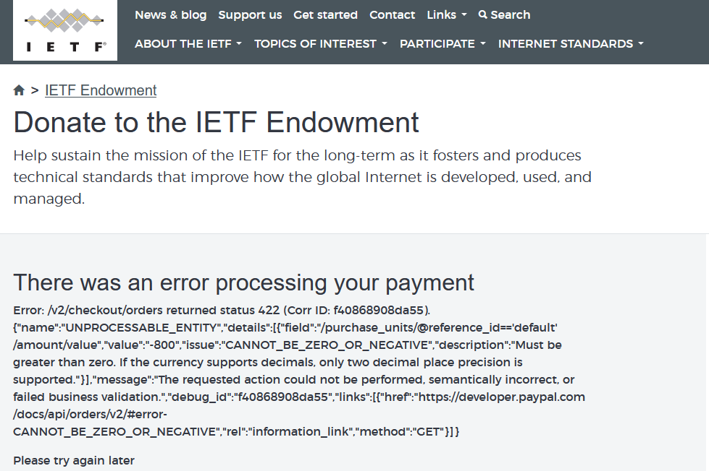
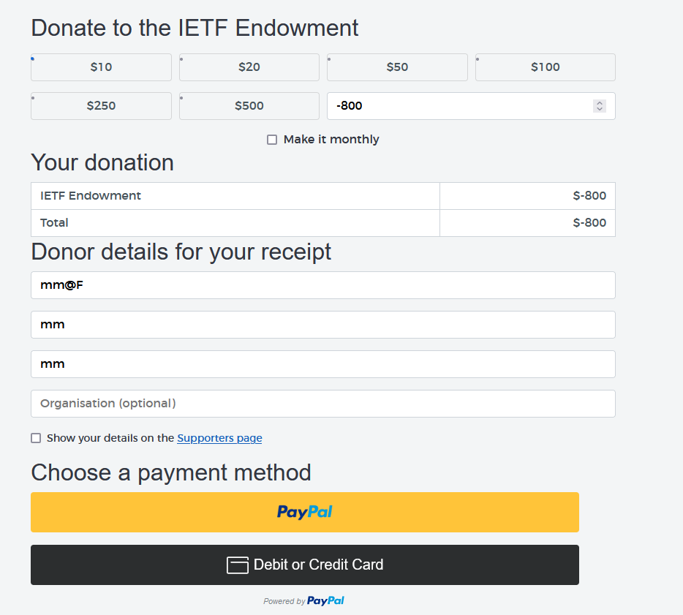
1

Slide 26
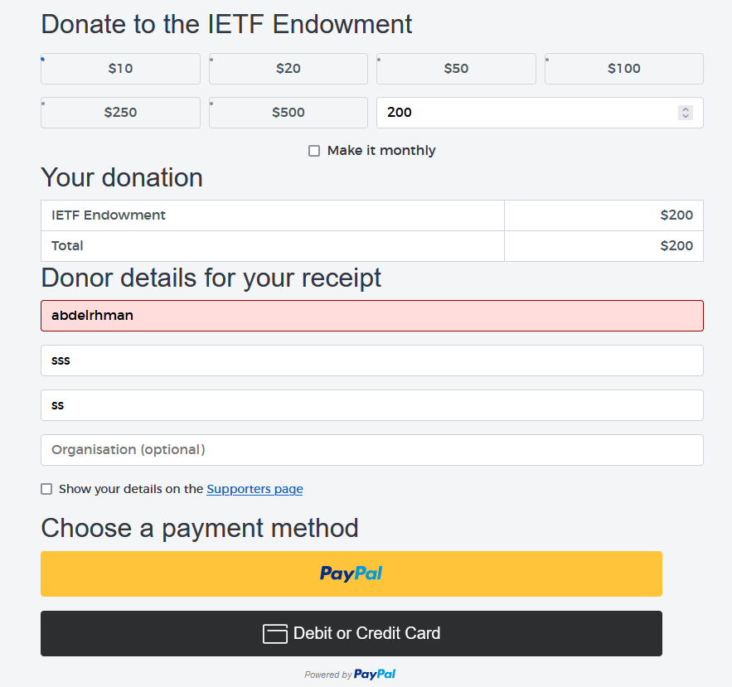
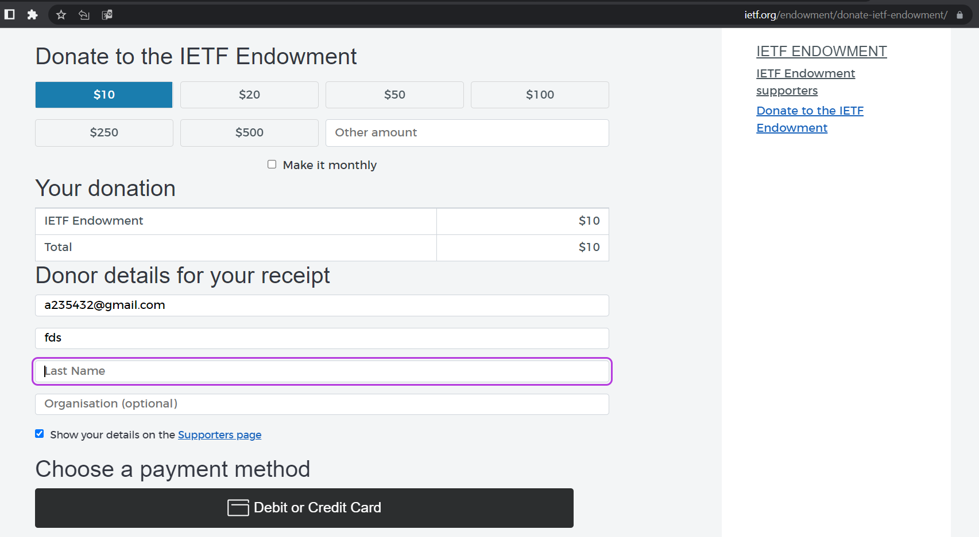
2
2

Slide 27
9- Contsraints
The website has some rules to make sure that users don’t try to do anything inappropriate.
Positive points:
The system doesn’t accept invalid inputs in donate form.
A payment method form in the donate doesn’t accept input unreal information.
Negative points:
That error message that comes while donating It's not understandable to users.
when the user submits the form without completing his information there is no message telling him to complete it (Just reloading the page).
Rating: (3/5)

Slide 28
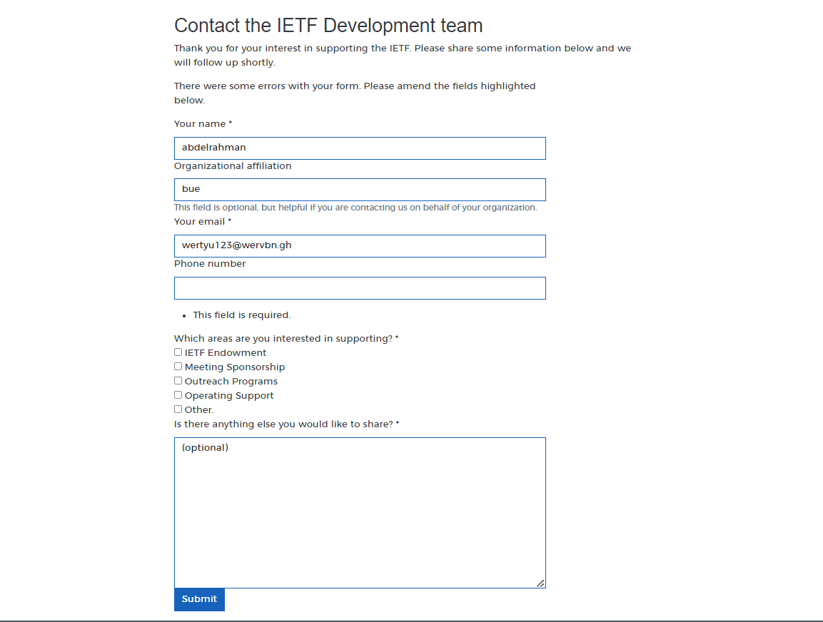
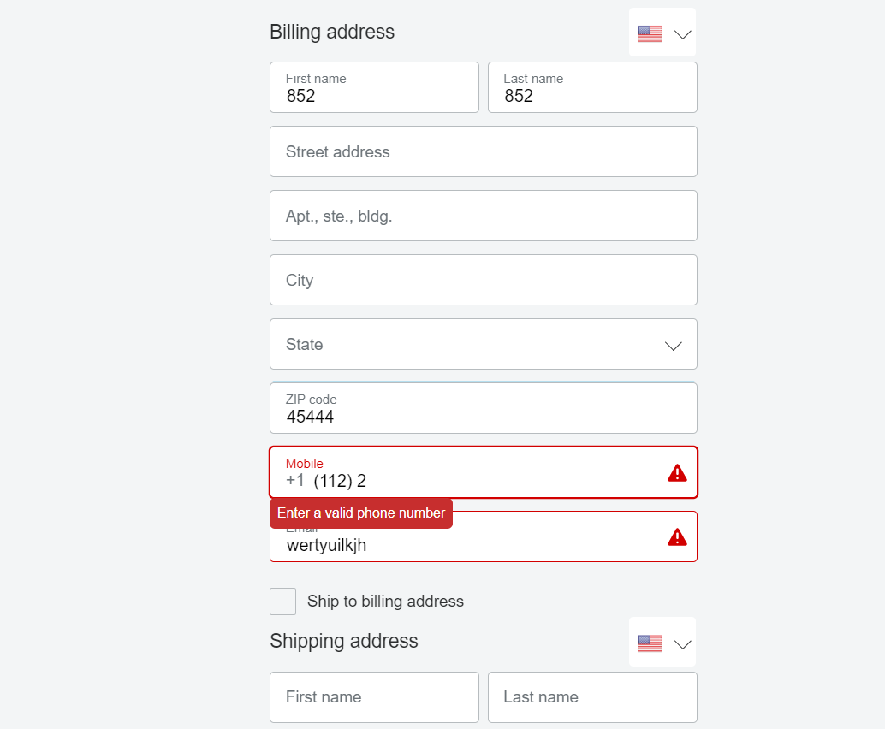
1
2
2
1

Slide 29
10- Flexibility
Allow different ways for users with different experiences in systems to do the same thing.
Positive points:
Users can reach the same page in several ways like going to the (IETF Area) page from more than one way.
Providing different ways to navigate around the site.
Negative points:
To contact the IETF developer team there is only one way through (support us).
There is no option on the navigation bar to get back to the home page (only by clicking the logo).
Rating: (2.5/5)

Slide 30
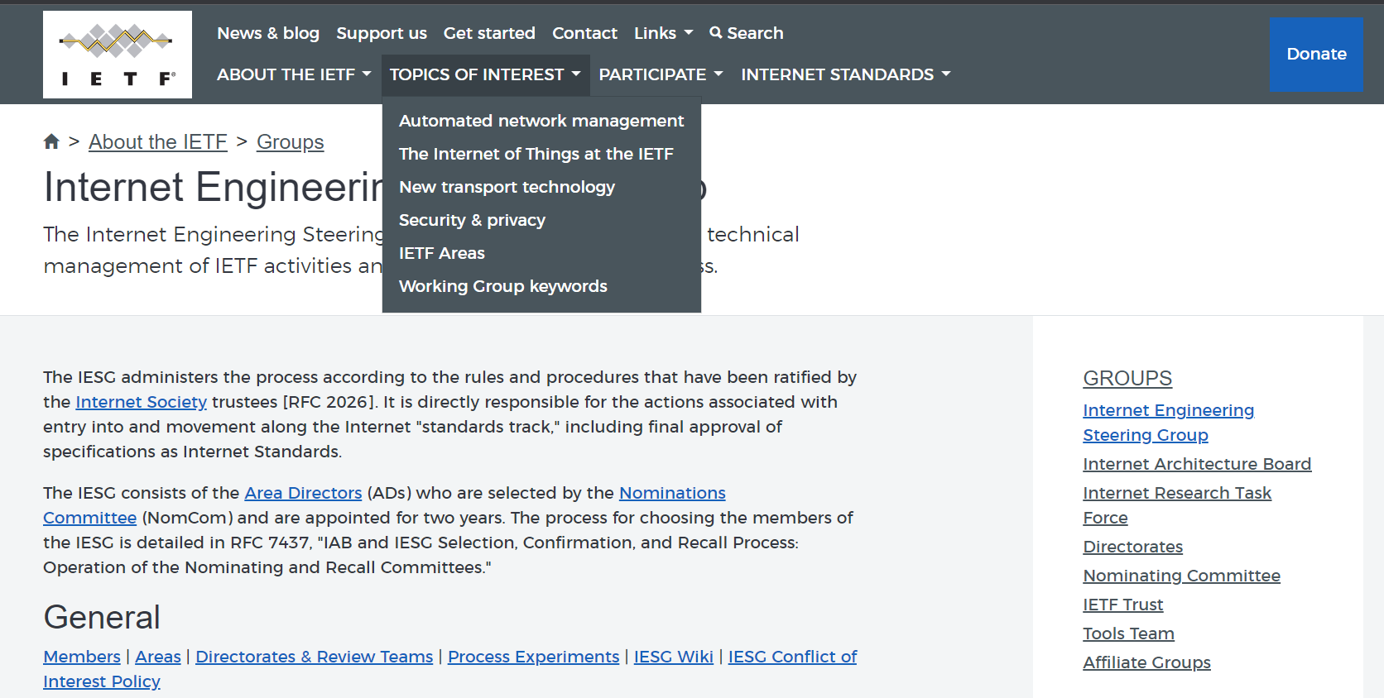
2
1
1

Slide 31
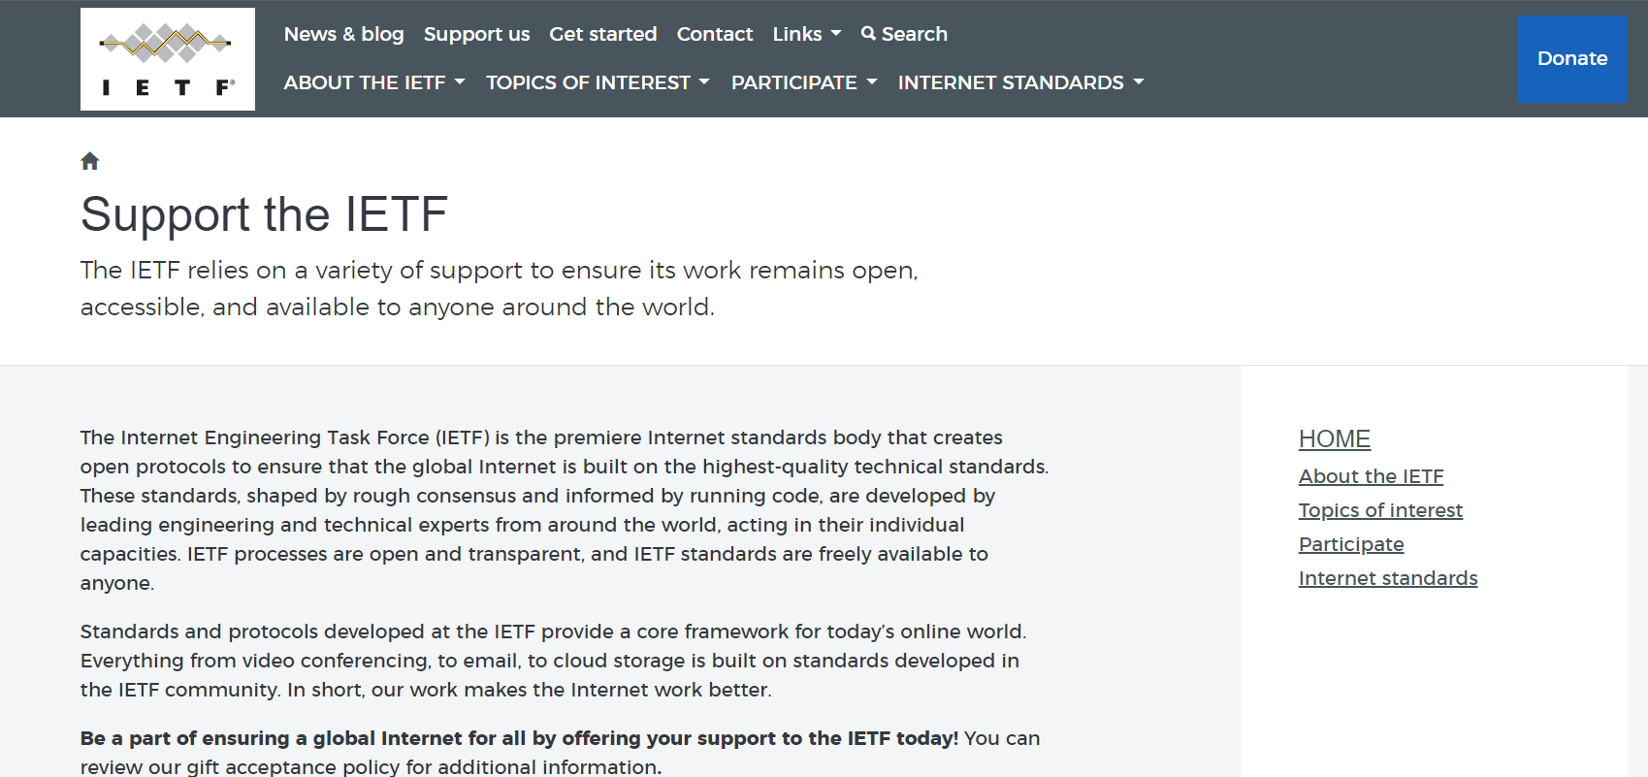
2

Slide 32
11- Style
The website is not designed to be attractive and stylish enough.
Positive points:
The background is blurred to direct the user’s attention to the main information(Contrast).
The titles are written in a bold font with a different colour and quats in italic font to mainly highlight them.
Donate form is stylish and attractive to motivate people to donate
Negative points:
The website’s colours are not balanced very correctly as the colour of Donate button isn’t suitable for the navigation bar colour.
The navigation bar is kind of crowded and not stylish.
The search boxes are not aligned correctly.
Some forms have no style.
Rating: (2/5)

Slide 33
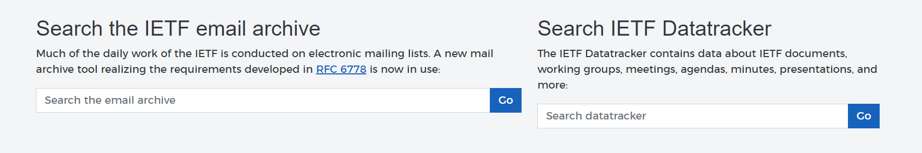
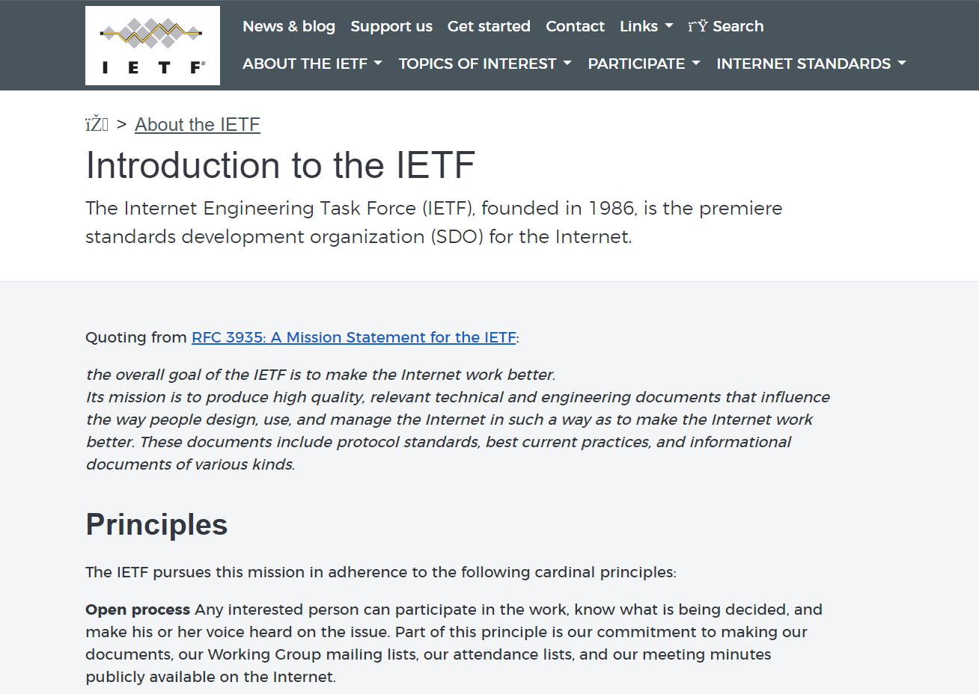
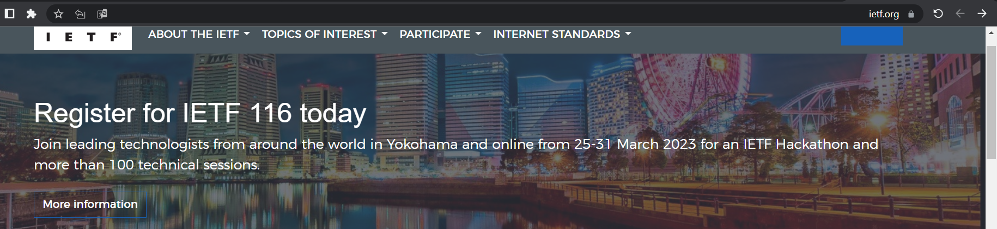
1
3
2
1
2

Slide 34
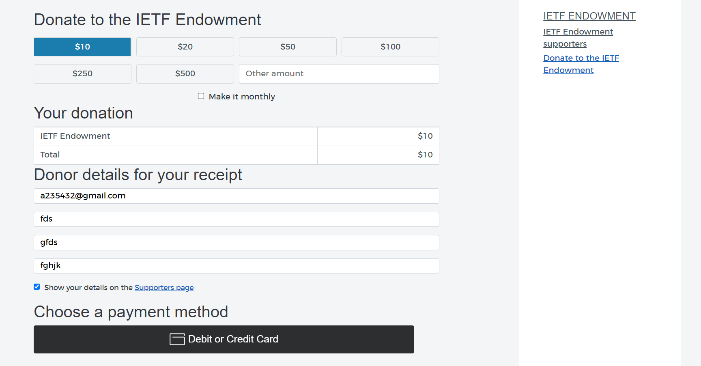
4
3

Slide 35
12- Conviviality
The website provides a number of friendly messages and descriptions. However, some provided messages cannot be sent for normal users.
Positive points:
Clear description of each section which is written in a formal and friendly way.
Friendly messages
Negative points:
Technical information that comes from the server which is not understandable for users.
Many technical info are included
Rating: (4.5/5)

Slide 36
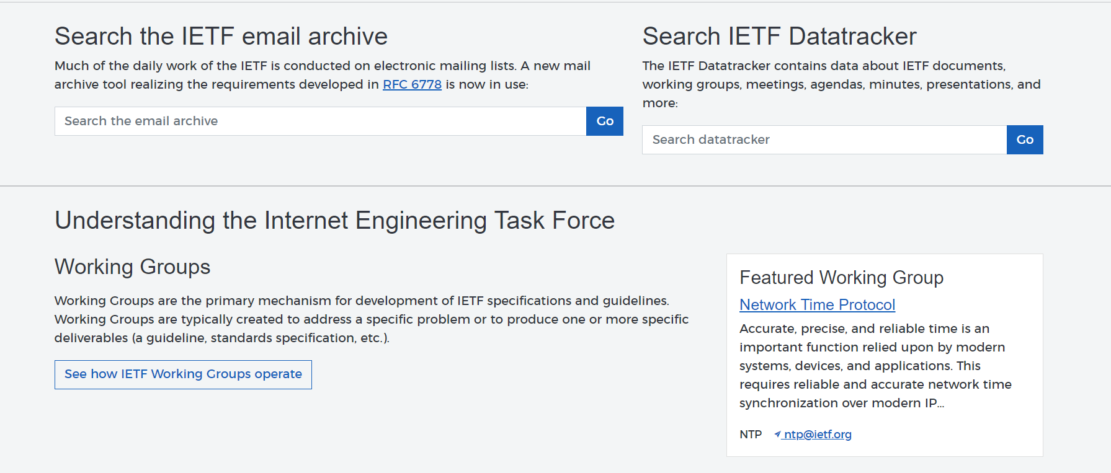
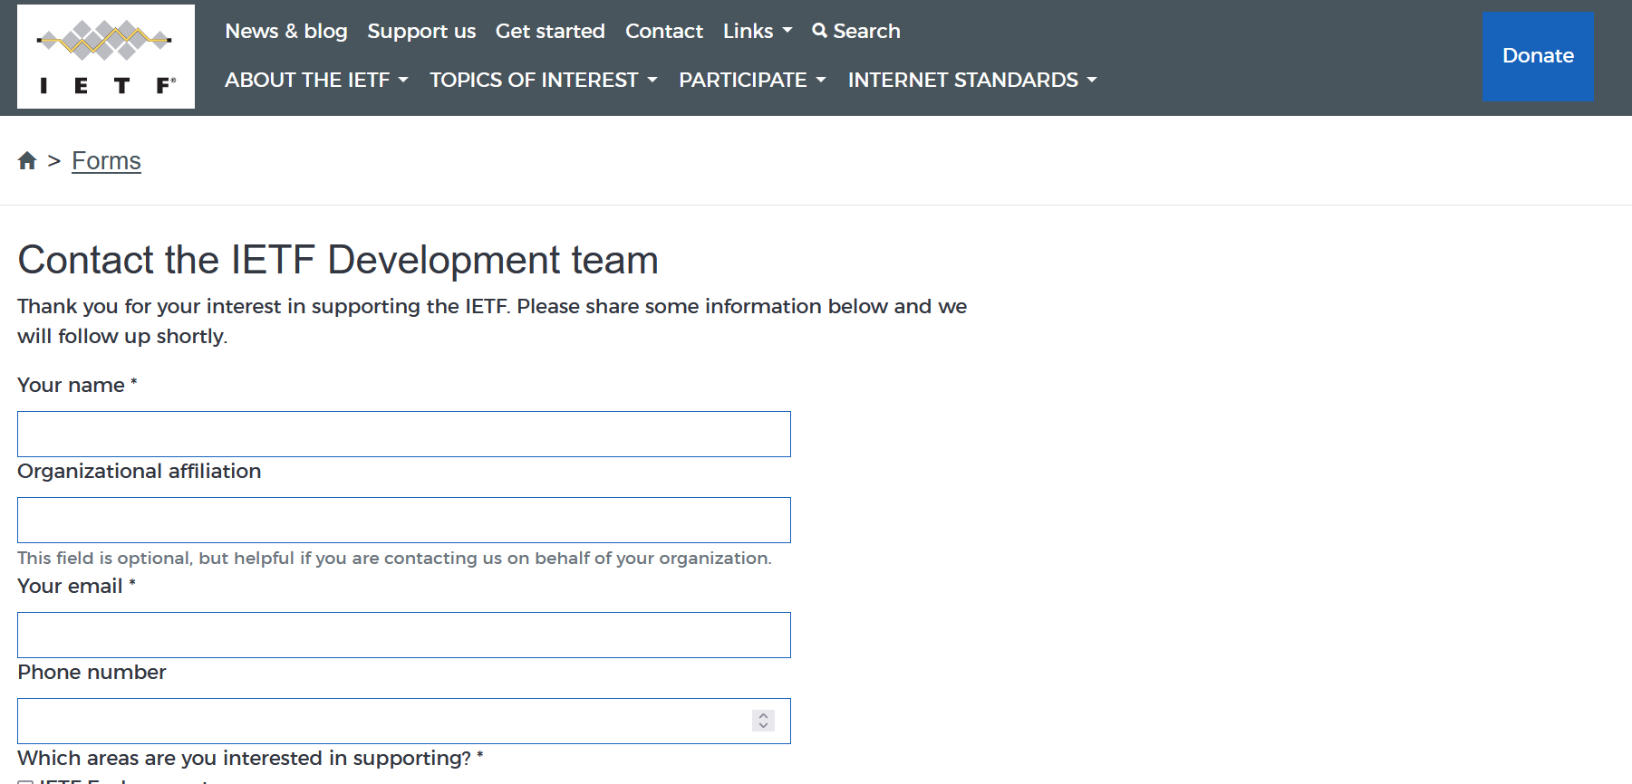
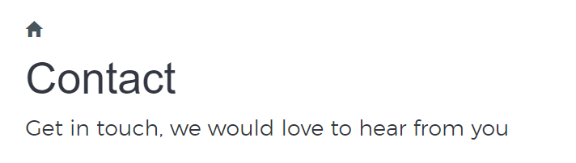
1
2

Slide 37
1

